Slide 1
Version Control using git
TACC SDS Course
October 1, 2019
Paul A. Navrátil, Ph.D.
Director of Visualization
pnav@tacc.utexas.edu

Slide 2
What is software version control?
A record of the state of a software development project
A means to coordinate collaborative effort across a project
An artifact for future developers to understand current and past development decisions and directions
A safety net in case Something Bad happens in or to the current version of the code (bugs, deleted files, etc)

Slide 3
Why use version control?
Easily share files and work in a systematic and organized way
Beats emailing files or sharing via cloud drive
Maintain a record of your work in case you need to go back
Like an “undo” command for your code!
Great habit to develop for future code development projects
Must-do in industry, increasingly expected in academia

Slide 4
When should I use version control?
When a project contains sufficient complexity
Multiple files
Multiple developers
Multiple versions
When someone (including you!) might use the code over an extended period
Bug fixes
Feature additions
Derived works
Even a single file, single developer project can benefit from version control tracking!
When did I do this?
Why did I do this?
How can I do this again!

Slide 5
Types of version control
Central repository
Single canonical repository maintained at single location
All developers synchronize file states to canonical repo
No notion of local commits, all commits require access central server
History typically maintained per file, global repository state must be explicitly marked, e.g. by a developer tag
History typically not maintained locally: smaller local state, but cannot recover history if central repository is corrupted or lost
Examples: CVS – https://www.gnu.org/software/trans-coord/manual/cvs/cvs.html Subversion – https://subversion.apache.org/
Distributed repository

Slide 6
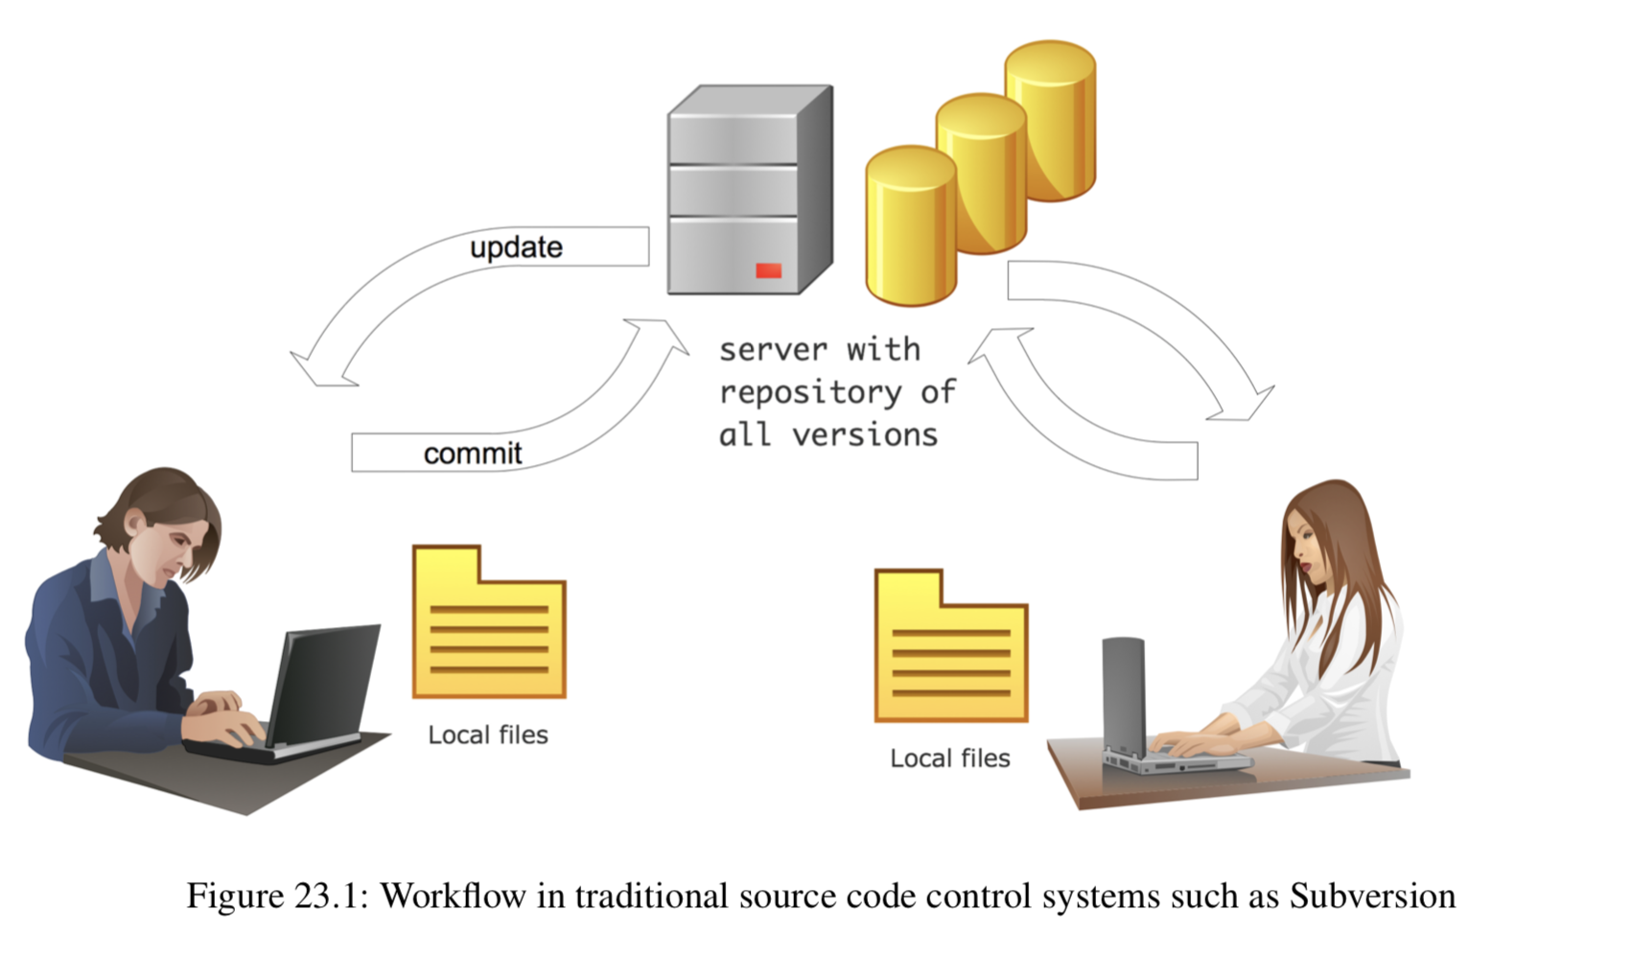
Central Repository
Figure from: Victor Eijkhout. Introduction to High Performance Computing

Slide 7
Types of version control
Central repository
Distributed repository
Repository history is stored at each repository instance Can use central repository pattern, but not required
Developer can make local commits, updates local commit history
Local history can be synchronized with remote instances of same repository
History is maintained global repository state, each commit captures the state of the entire repository
Synchronized repository history recoverable from remote repository
Examples: git – https://git-scm.com/ mercurial – https://www.mercurial-scm.org/

Slide 8
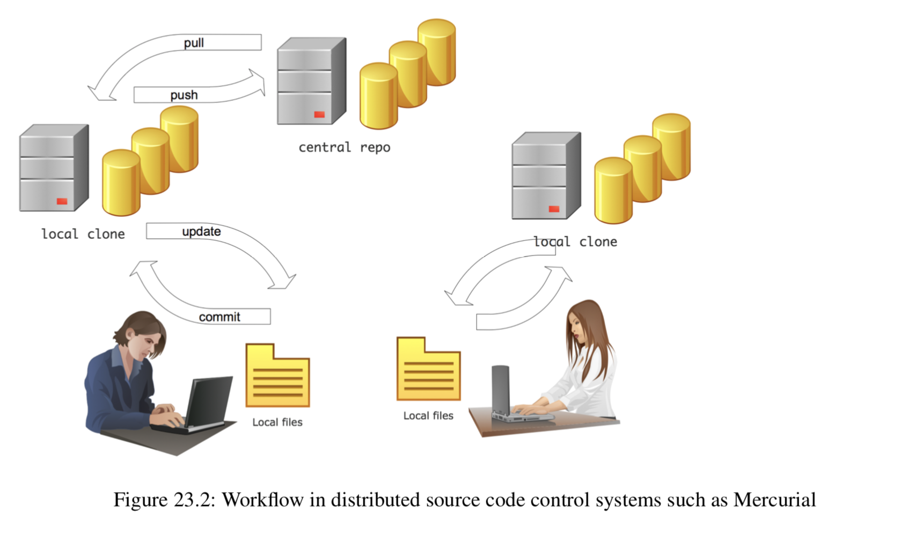
Distributed Repository
Figure from: Victor Eijkhout. Introduction to High Performance Computing

Slide 9
Distributed Repository
Can sync local repositories directly (assuming accessibility)
Figure from: Victor Eijkhout. Introduction to High Performance Computing

Slide 10
Distributed Repository Best Practices
Keep (at least) a master and a development branch
Use master for code releases (should always “work”)
Use development for new feature development and synching with other development team members
Use local branches for longer task and feature development
Keeps development sync-able without many local changes
Merge back into local development as tasks are completed
Minimize use of additional remote branches
Tag releases (with semantic versioning https://semver.org/ )
Use a (free) continuous integration server ( https://travis-ci.org/ )

Slide 11
Focusing on git …
Common source control manager for open-source software
Many cloud-based repositories, come with issue tracking, wiki, perhaps some CI processing, project management boards
https://github.com/ (free for public repos)
https://bitbucket.org/ (free for students)
https://about.gitlab.com/ (free for small projects)
Can create your own git repo on a local or remote system!
Use git init for a local repo where you will also develop
Use git init --bare for a remote (or local) repo using a central repo pattern
Use git init --bare --shared for remote repo to preserve group perms

Slide 12
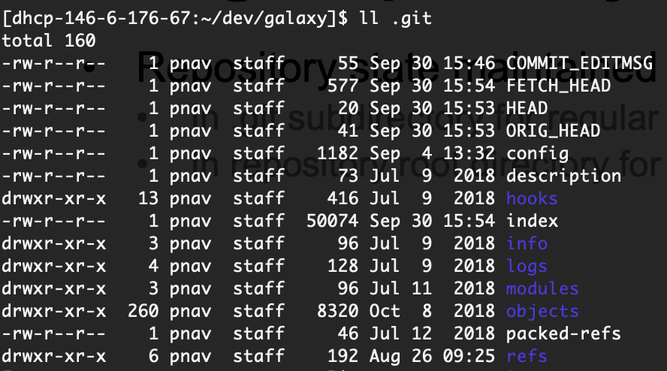
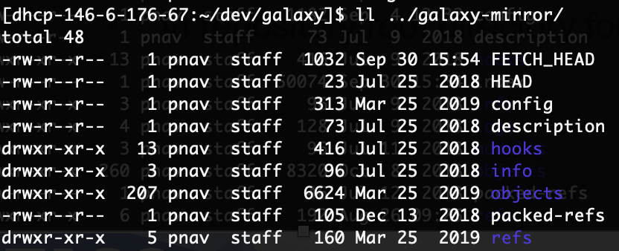
The git repository
Repository state maintained locally
In .git subdirectory for regular repositories
In repository root directory for “bare” repositories
The config file contains configuration info, can edit directly, but don’t ☺

Slide 13
Getting code from a repository
“Clone” the code to a local directory, which will create a subdirectory for the repository in the current working directory git clone <path> <optional subdir name> git clone /my/local/repo.git my-repo-name git clone https://github.com/TACC/AwesomeCode.git

Slide 14
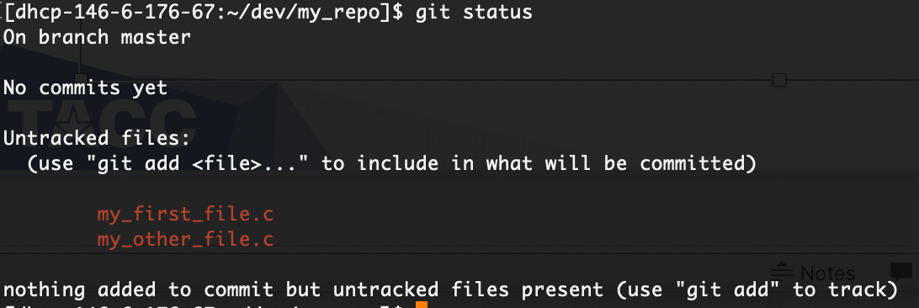
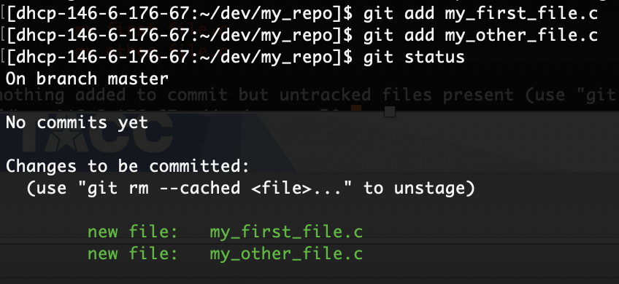
Telling git about your files
A new repository starts off empty! You will need to add files to it explicitly: git add my_first_file.c git add my_other_file.c

Slide 15
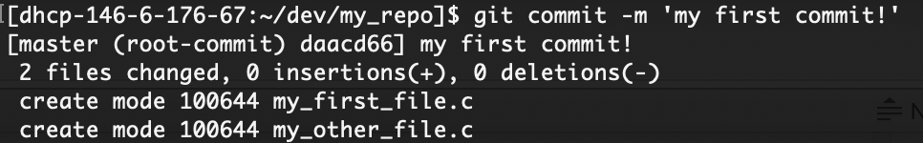
Telling git about your files
At this point, the files are staged to be added, but they are not yet committed to the repository git commit –m ”my descriptive commit comment”

Slide 16
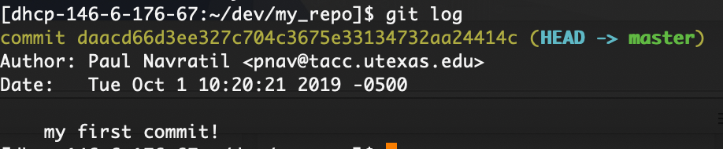
Telling git about your files
You might have noticed how to check the status of git: git status
Now that there are committed changes, we can see the history of the commits in the git log: git log

Slide 17
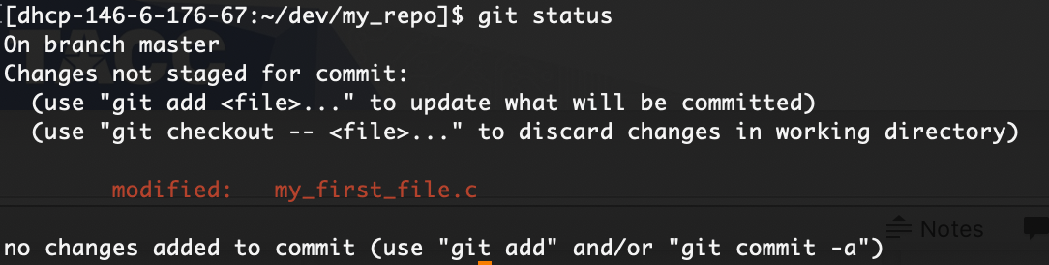
Updating files
Git tracks when the contents of a file changes, and will mark it as containing uncommitted changes

Slide 18
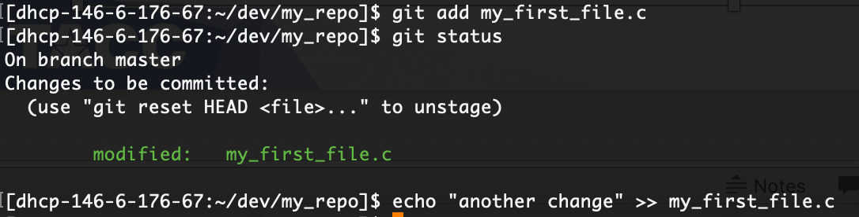
Updating files
Let’s add that file to be staged….
But what happens if we update it again before a commit?

Slide 19
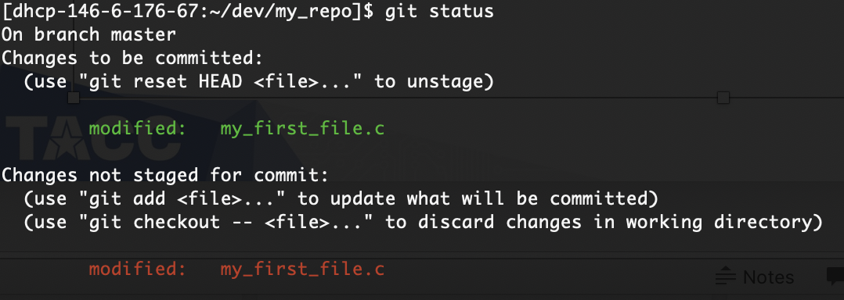
Updating files
Git shows that the file has been updated since the last git add!
This is a Good Thing: git only does what you expressly tell it to do
It can make a little extra work, but it protects us from doing Something Dumb!

Slide 20
Updating files
Also note that there are several options that git suggests for addressing the changed file:
git reset HEAD my_first_file.c will unstage all uncommitted changes to my_first_file.c
git add my_first_file.c will add the second change for commit
git checkout -- my_first_file.c will discard the unadded change(s) to my_first_file.c

Slide 21
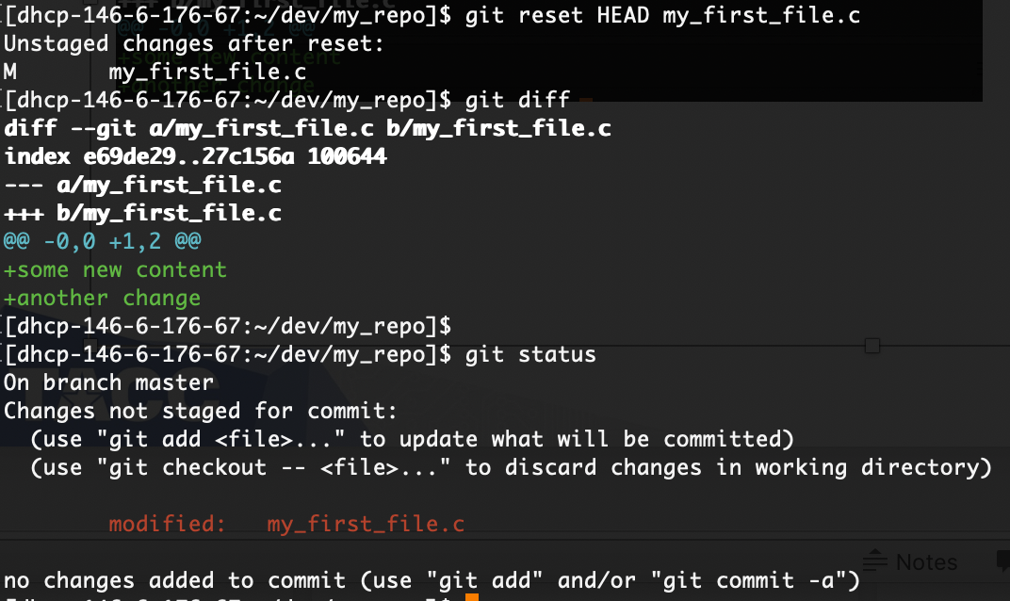
Updating files
After git reset, all changes unstaged

Slide 22
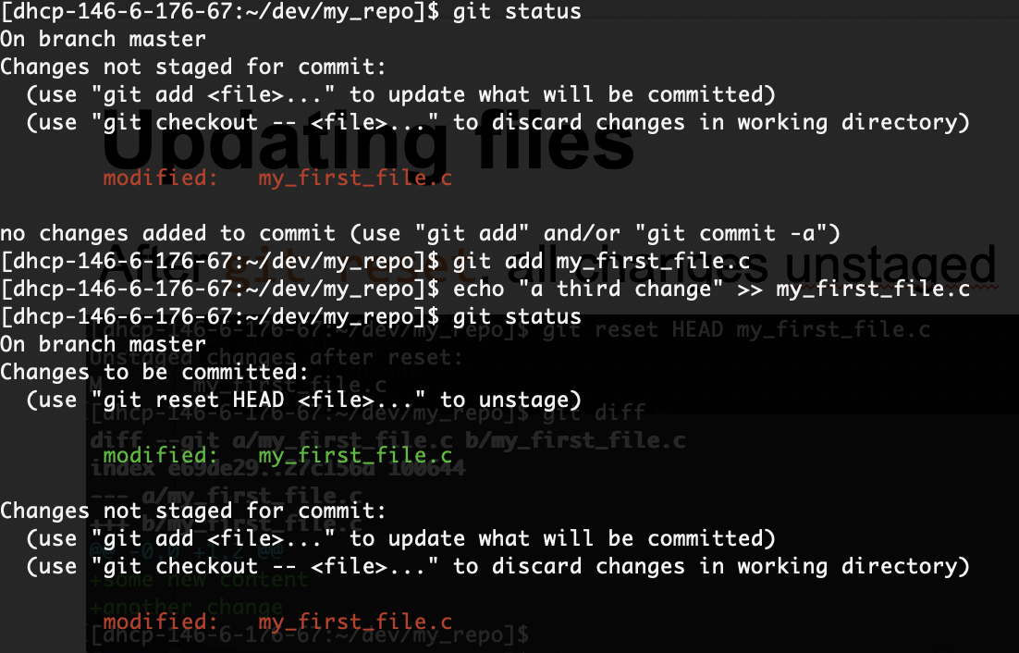
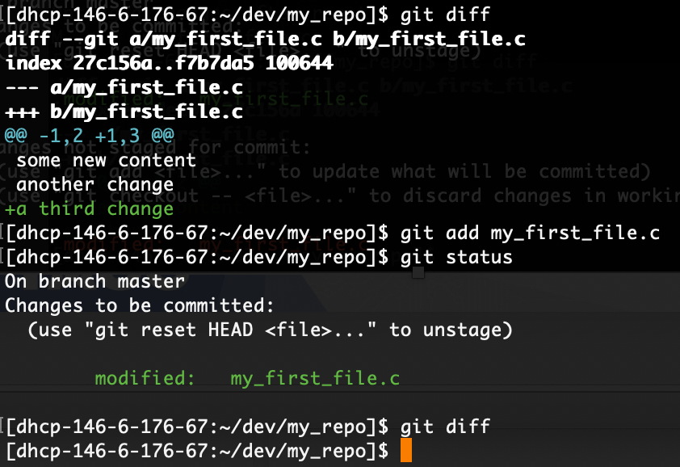
Updating files
After git add, new changes are staged for commit

Slide 23
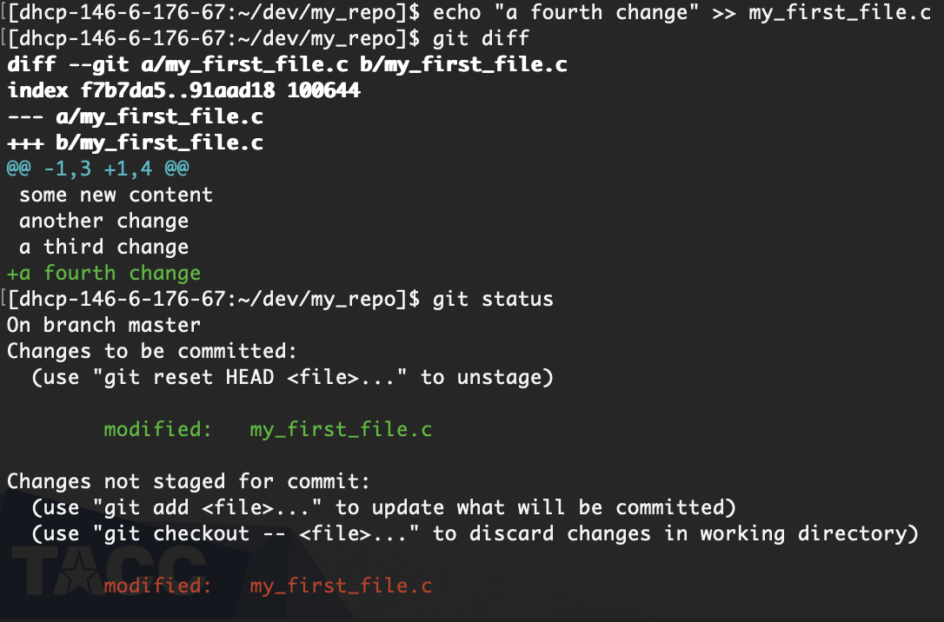
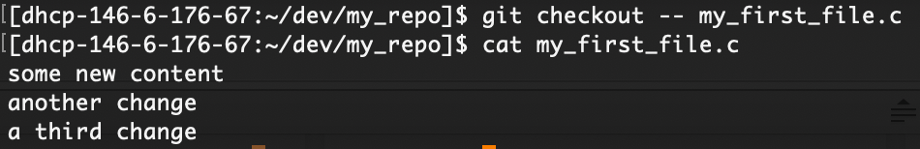
Updating files
After git checkout -- <file>, all unstaged changes are discarded

Slide 24
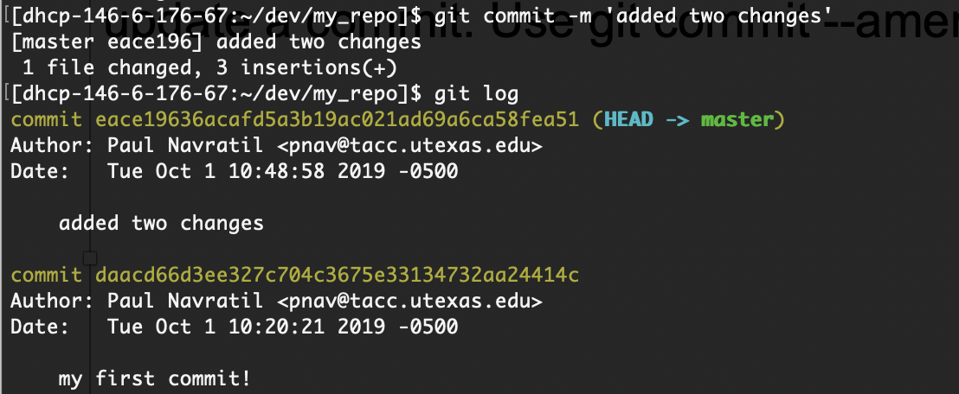
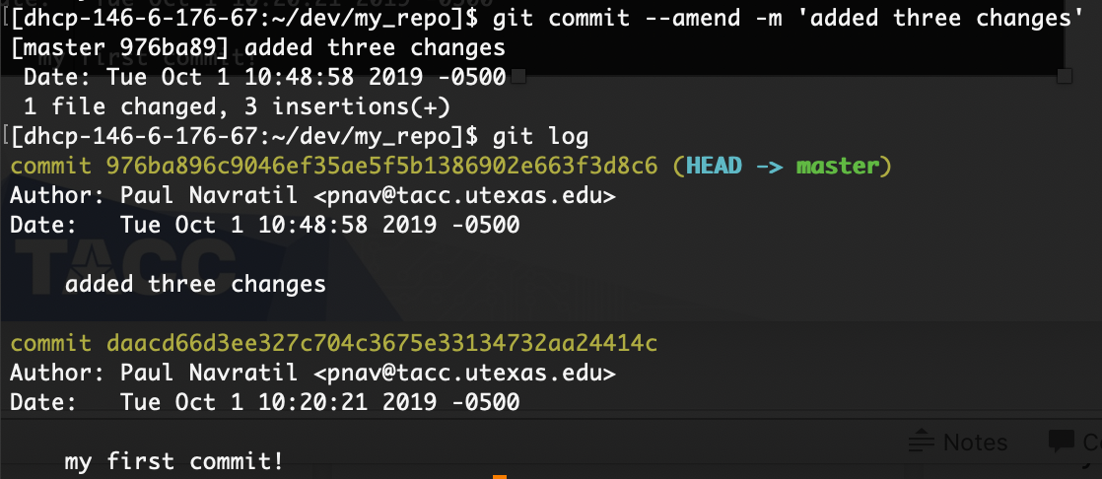
Updating a commit
Sometimes we are too quick on the commit trigger, and want to update a commit. Use git commit --amend
NOTE: only amend in a local repository. If you have pushed to a remote repository, make a new commit instead!

Slide 25
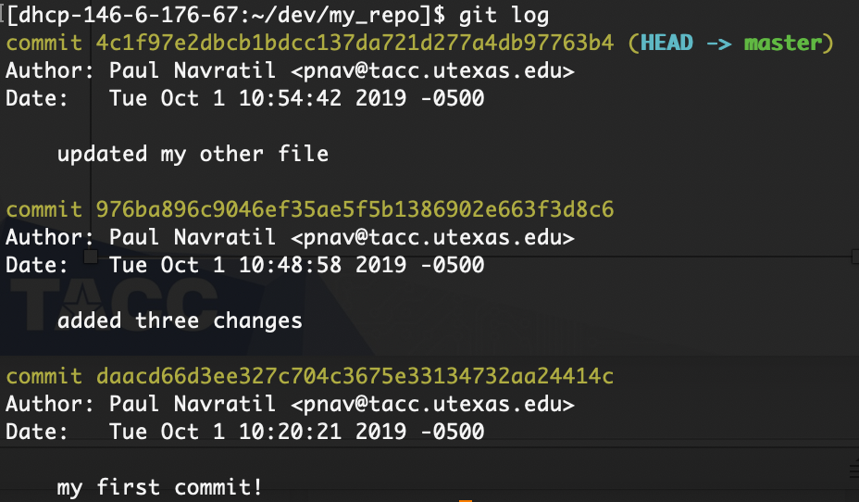
More about git commit
Each commit has a unique hash signature that can be used to reference it!

Slide 26
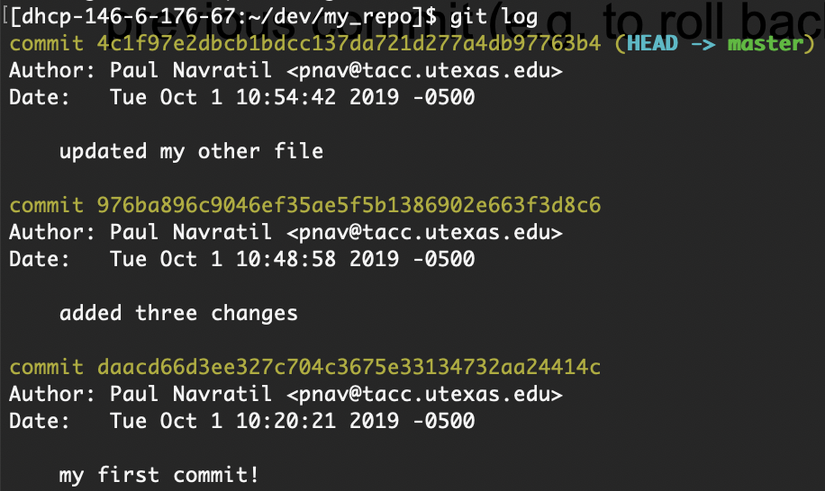
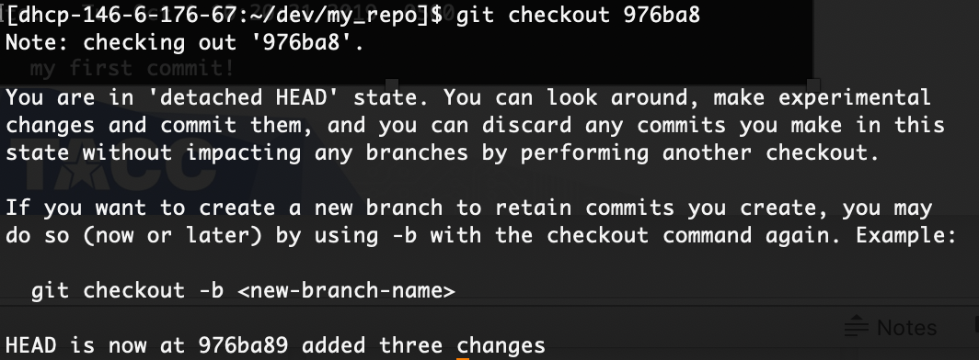
More about git commit
Use the unique hash (sometimes called a “sha”) to checkout a previous commit (e.g. to roll back, branch, or test).

Slide 27
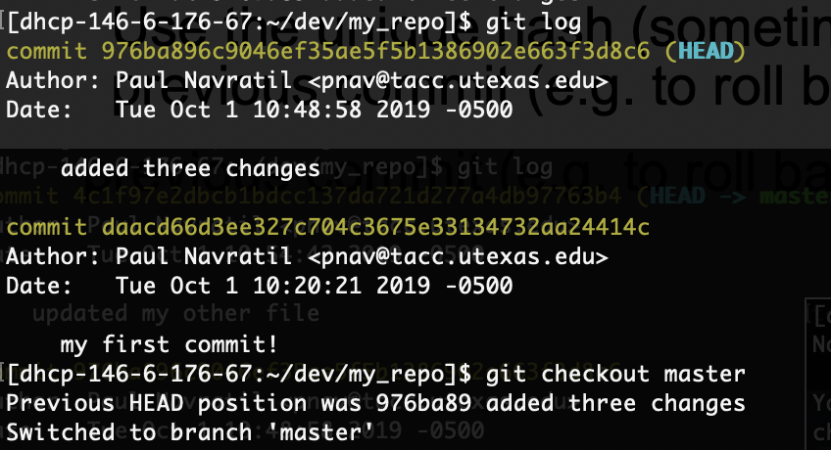
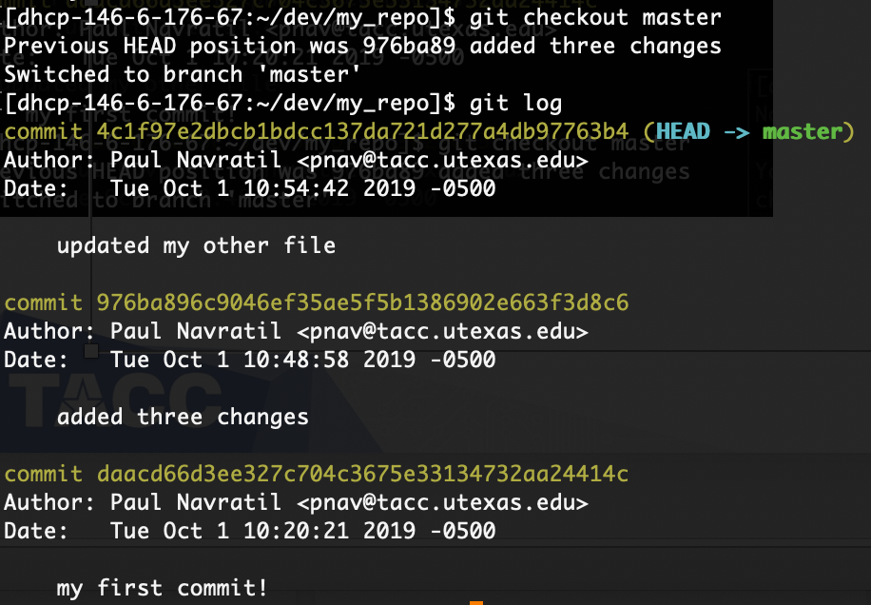
More about git commit
Use git checkout <branch or sha> to return from the detached state

Slide 28
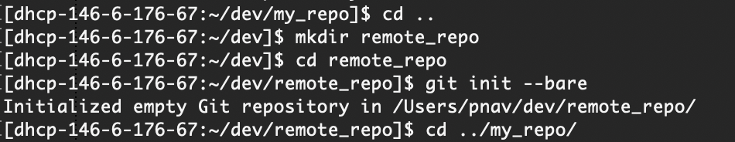
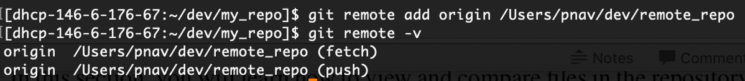
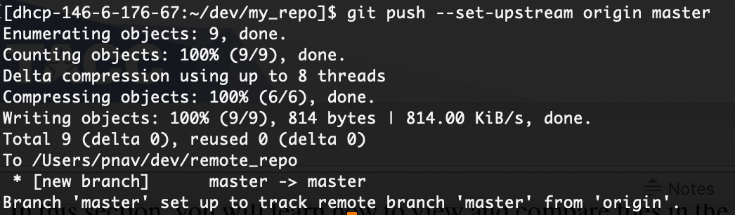
Pushing to a remote repository
A remote repository is a repository other than your local working repository.
This is a logical distinction: the ”remote” repo can be on your local machine or on a remote machine.
The repo needs to exist (easiest if it is empty but doesn’t need to be)

Slide 29
More about git branch
A branch is a separate version stream of the repository
Shared origin point in the version history
Useful for maintaining state separate from shared branches or for shared development separate from primary branches (for example, development vs. master)
Branches can be kept local or pushed to remote repos
If remote, you set a remote tracking branch with git push --set-upstream <remote> <branch>
Primary uses are to isolate feature development from other work on development branch(es), and to isolate all feature development from the released versions on master

Slide 30
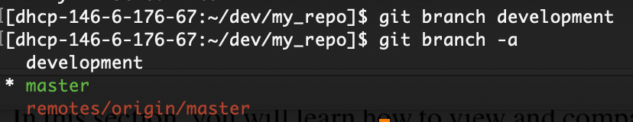
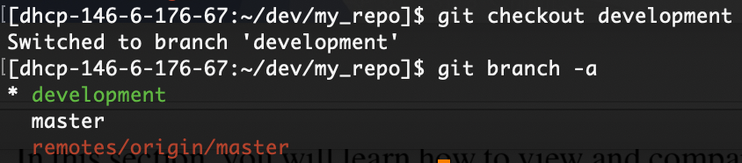
Creating and using a branch
Create a branch from the current repository version with git branch <name>
Then move to the branch with git checkout <name> (remember, git only does what you tell it!)

Slide 31
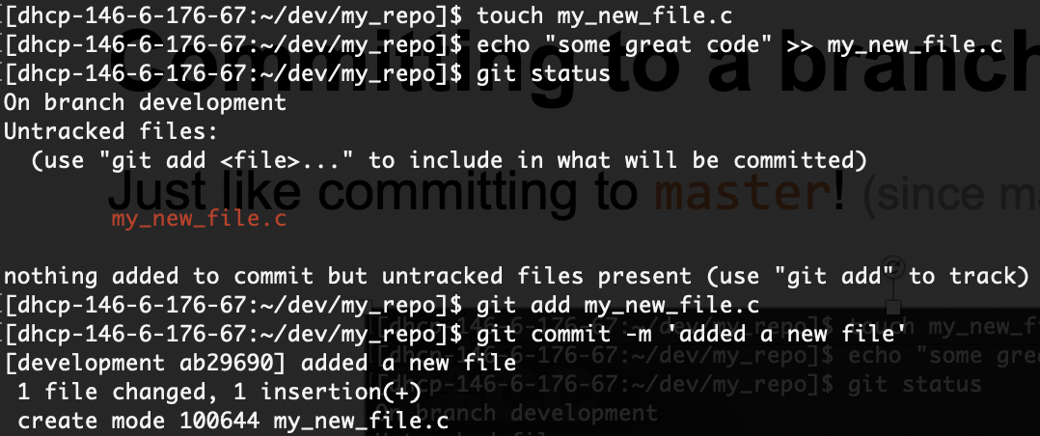
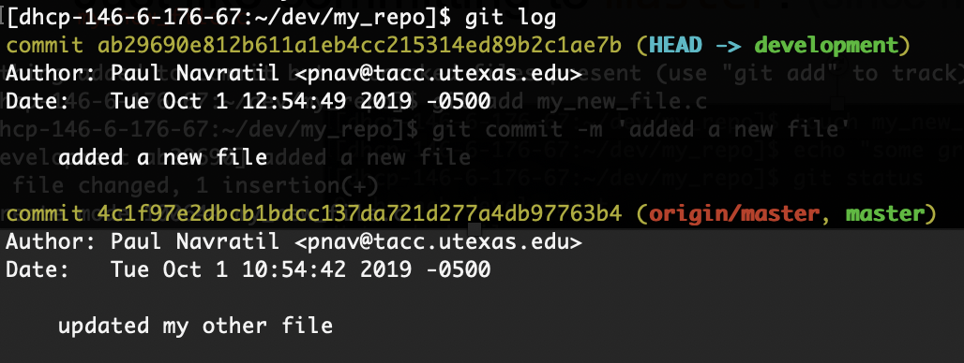
Committing to a branch
Just like committing to master! (since master is also a branch ☺)

Slide 32
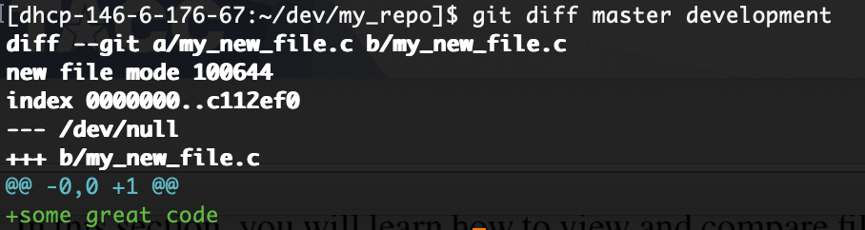
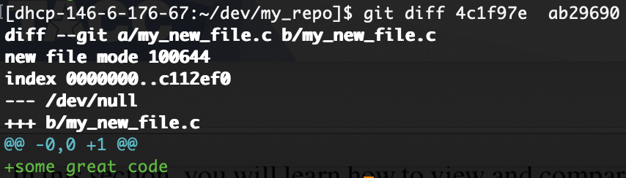
More about git diff
Shows the difference between two repository states (files, directories, branches, etc)
Can use branch names (will compare HEAD versions) or specific sha codes

Slide 33
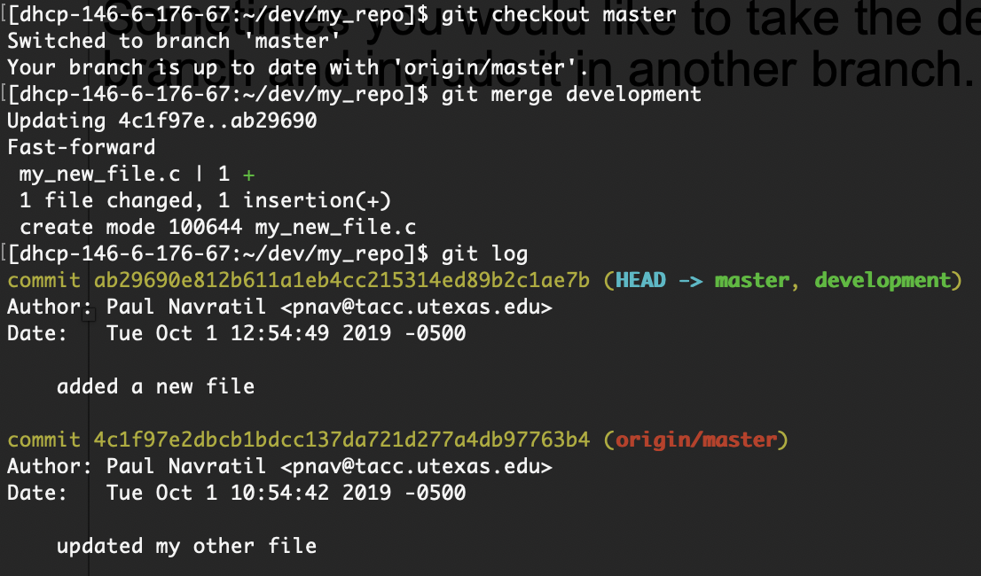
Merging branches
Sometimes you would like to take the development from one branch and include it in another branch. Use git merge

Slide 34
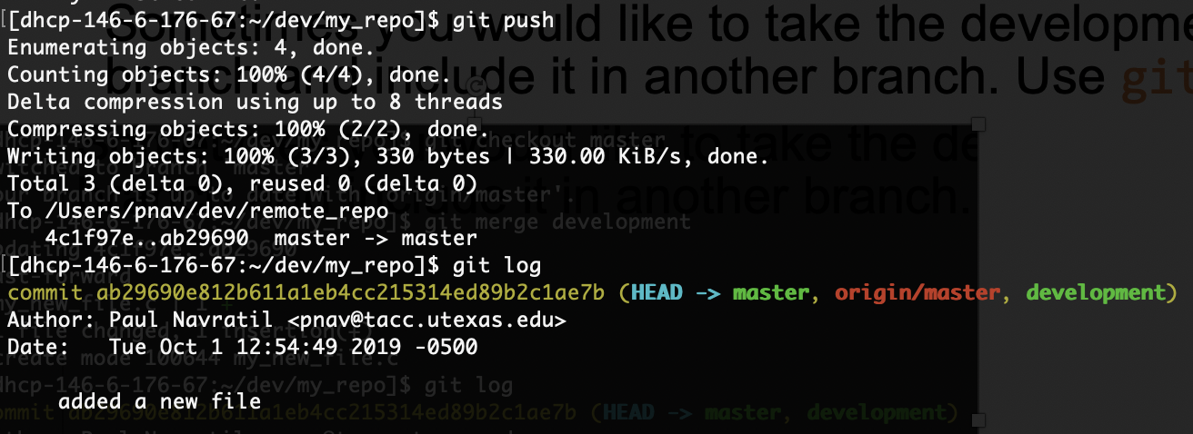
Merging branches
Remember! Repository changes are only local until you push!
Again, git only does what you tell it, and this is a Good Thing ☺

Slide 35
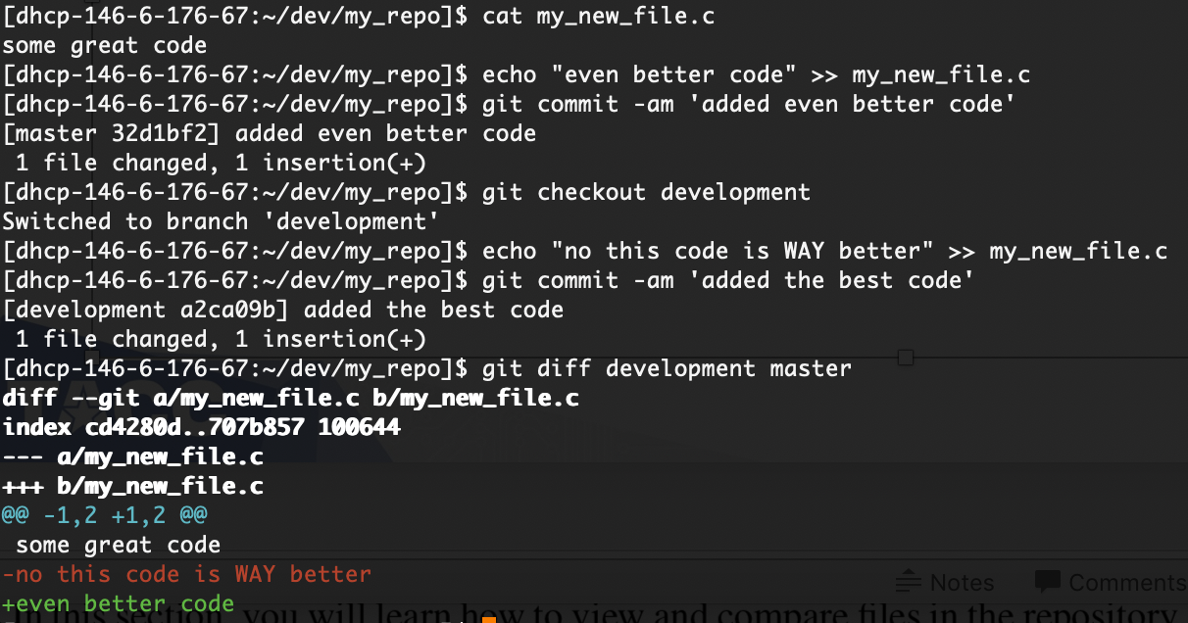
Merge conflicts
Git will try to automatically merge files and generally does a good job, but sometimes there are conflicts, like when edits occur to the same lines…

Slide 36
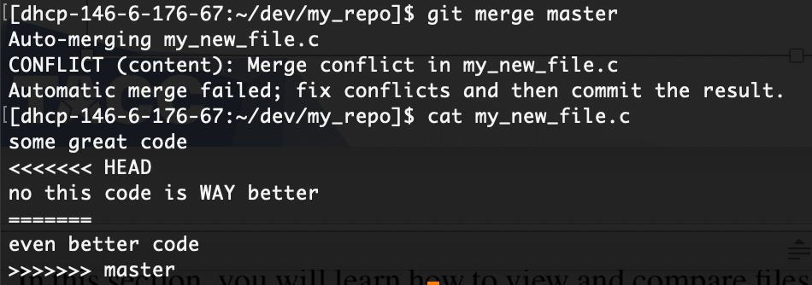
Merge conflicts
If we now try to merge master and development, we will get a conflict on the second line of my_new_file.c
Git marks the conflicting region and shows both versions.
We must hand edit the file to resolve the conflict.
We can pick one, the other, or some combination of both versions.

Slide 37
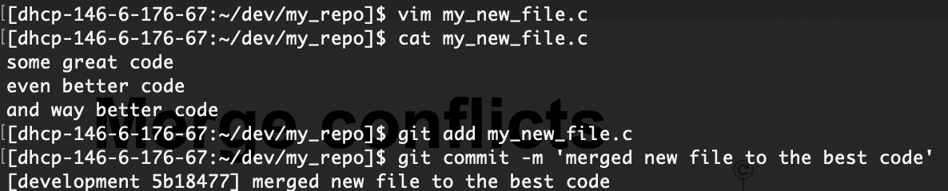
Merge conflicts
Hand-edit the code to remove the conflict, then commit the file.
Make sure to remove all ‘>>>>>’ and ‘<<<<<‘ annotations!

Slide 38
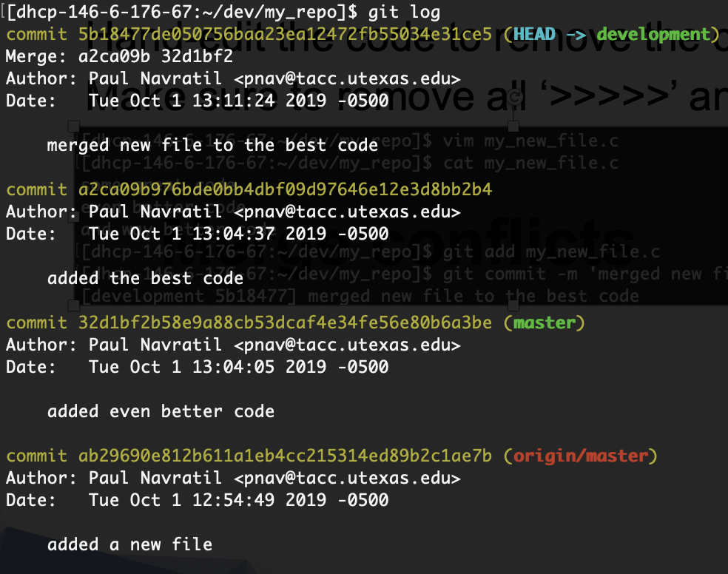
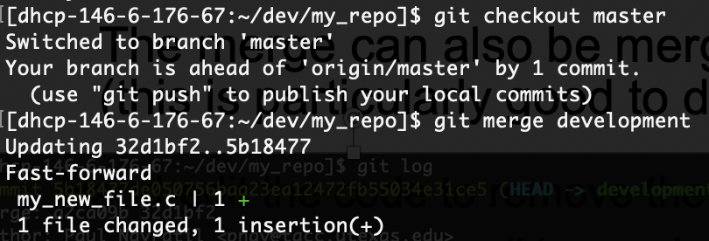
Merge conflicts
The merge can also be merged back into the other branch (this is particularly good to do if there were conflicts)

Slide 39
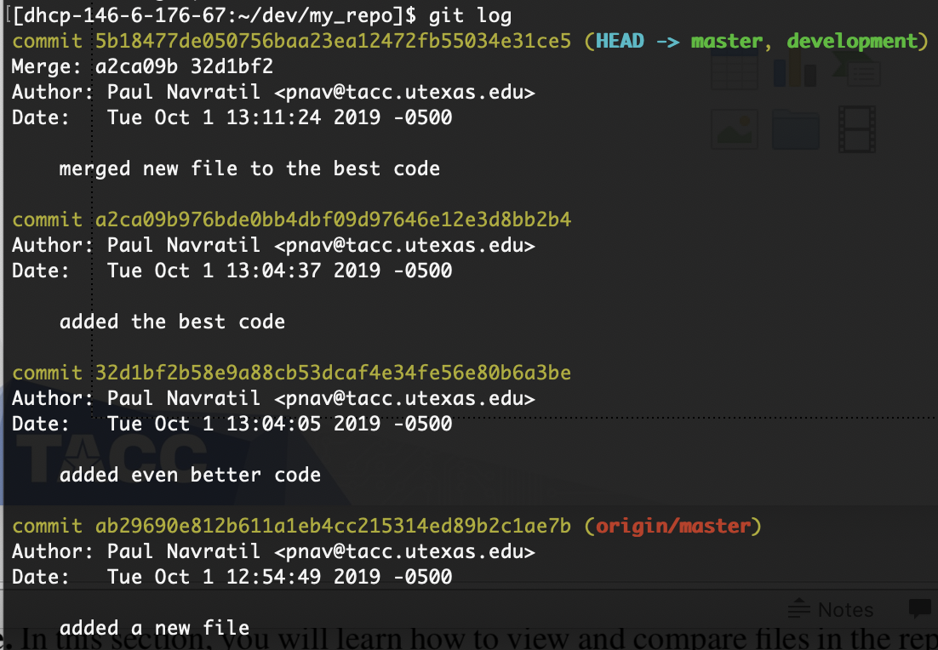
Merge conflicts

Slide 40
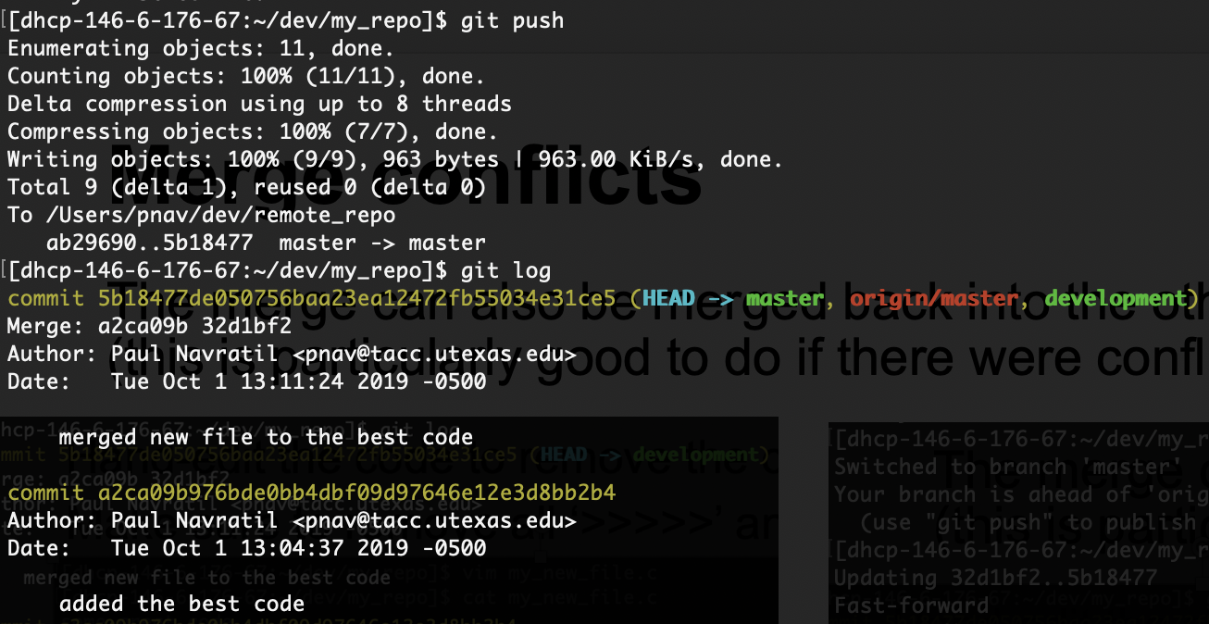
Merge conflicts

Slide 41
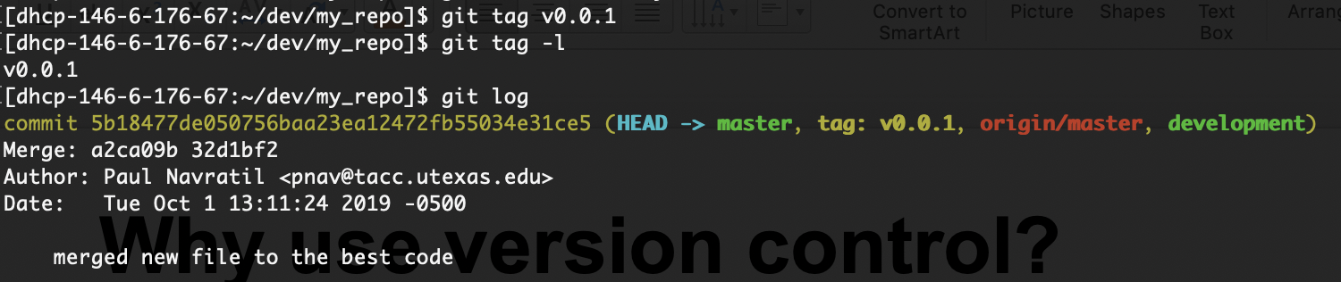
A bit about git tag
A git tag is another way to reference a repo state, typically used for to mark versioned releases
Consider using semantic versioning for release numbering, where major, minor and bug-fix increments respect promises about functionality and interface ( see https://semver.org/ )

Slide 42
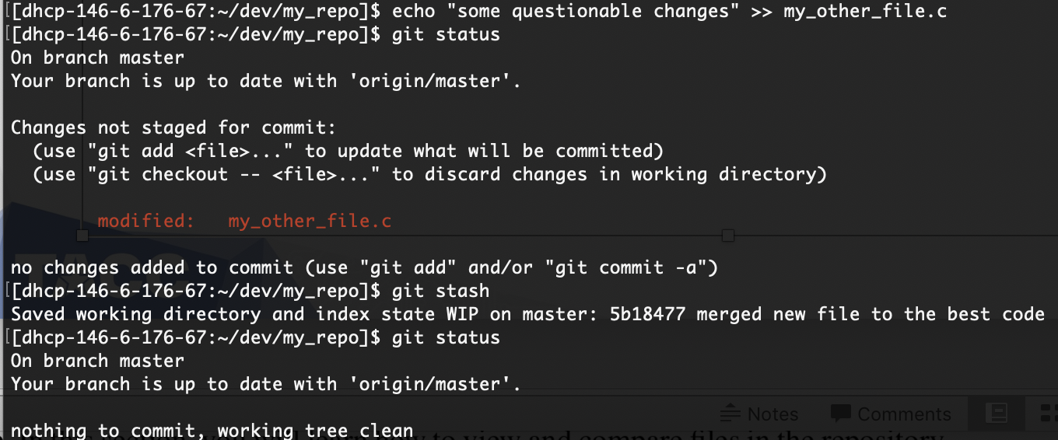
A bit about git stash
Sometimes you need to change repository state while you have changes that you are not quite ready to commit. Use git stash!
The git stash command pushes uncommitted changes onto a stack, and you can push multiple changes onto the stack

Slide 43
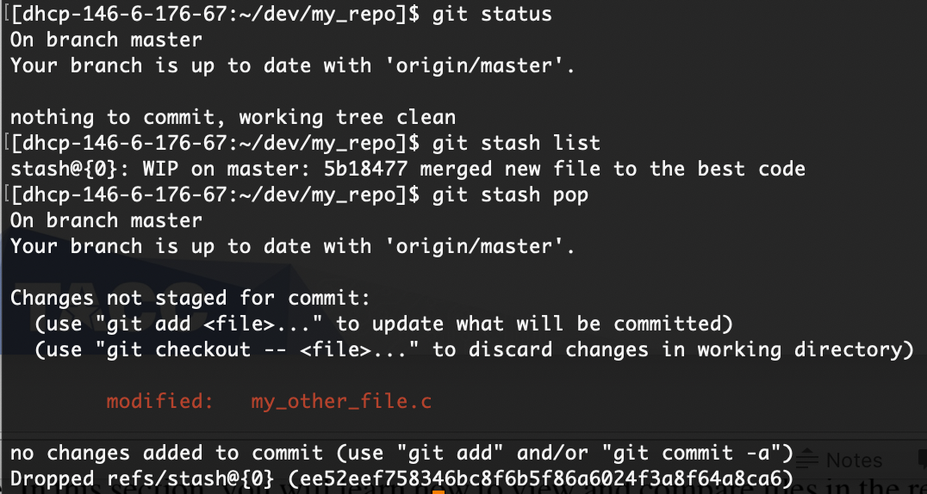
A bit about git stash
Recover the stashed changes with git stash pop or git stash drop

Slide 44
Advanced git topics
Pre-commit and post-commit hooks
Perform operations on added files either before commit (e.g. checking for illegal characters) or after commit (e.g. applying code style formatting)
Pull requests
Useful for contributing to remote repository without write access
Make a fork of remote repo to your remote repo (e.g. on GitHub)
Make updates and commit to a branch in your fork
Make pull request to remote repo owners to merge in your changes
Git documentation
https://git-scm.com/doc

Slide 45



Thank you! Paul Navrátil pnav@tacc.utexas.edu

